Slide 1
Musical genre trends across the ages!
Anna Cameron, Enya Tan, Mubarak Ganiyu, Sriram Kannan

Slide 2
Introduction
Overarching questions:
How do the characteristics of songs differ over time and across genres?
How do these characteristics relate to one another with regards to genre?
Characteristics of Interest:
Danceability, Instrumentalness, Valence, Energy, Loudness, and Acousticness
Genres: Blues, Country, Jazz, Rock, Hip Hop, Reggae, and Pop

Slide 3
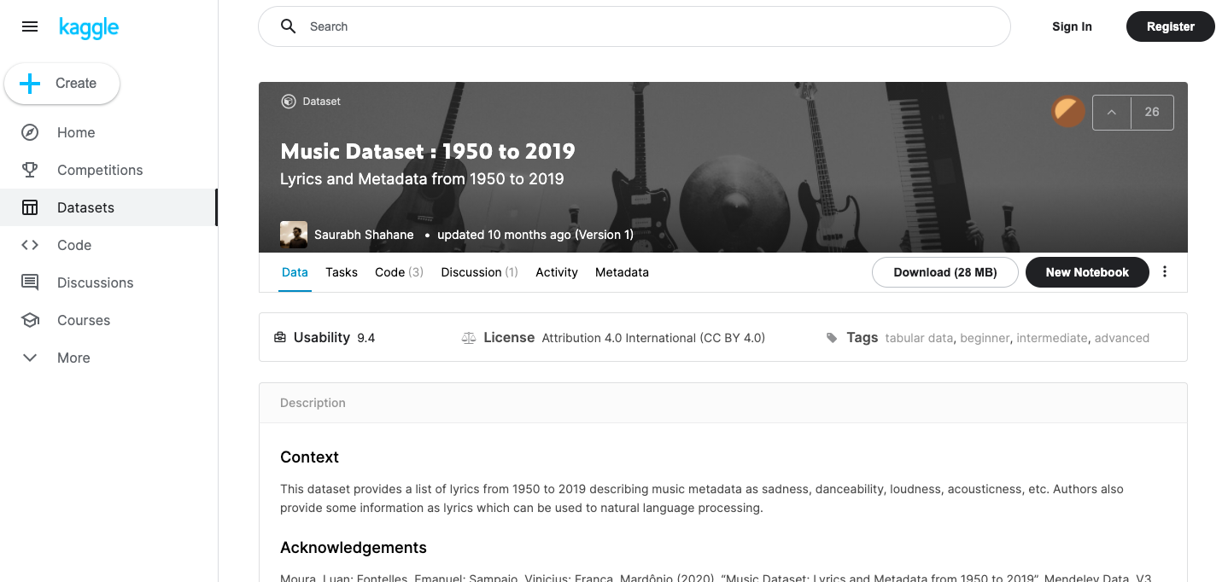
Collection
The Music data set was collected from Kaggle : The dataset contains 31 variables and 28372 observations - songs from 1950-2019.
The data was created by Saurabh Shahane

Slide 4
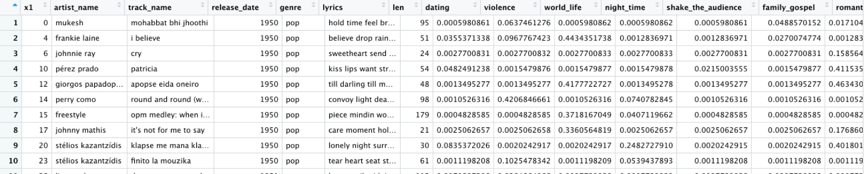
Cleaning - Original data
Adjusted column names, where spaces are changed to underscores and uppercase letters are converted to lowercase letters
Checked for missing information
Used assertr to check if relevant variables fall in the 0-1 range

Slide 5
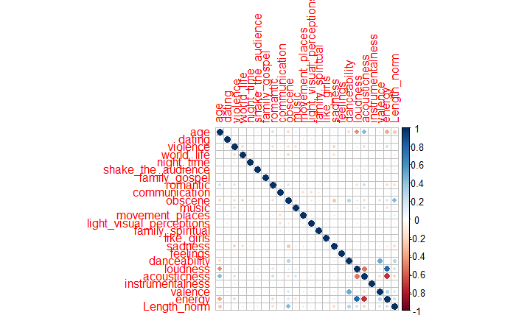
Cleaning - Original data
Created a Correlation Matrix to decide which variables to exclude
Removed irrelevant variables

Slide 6
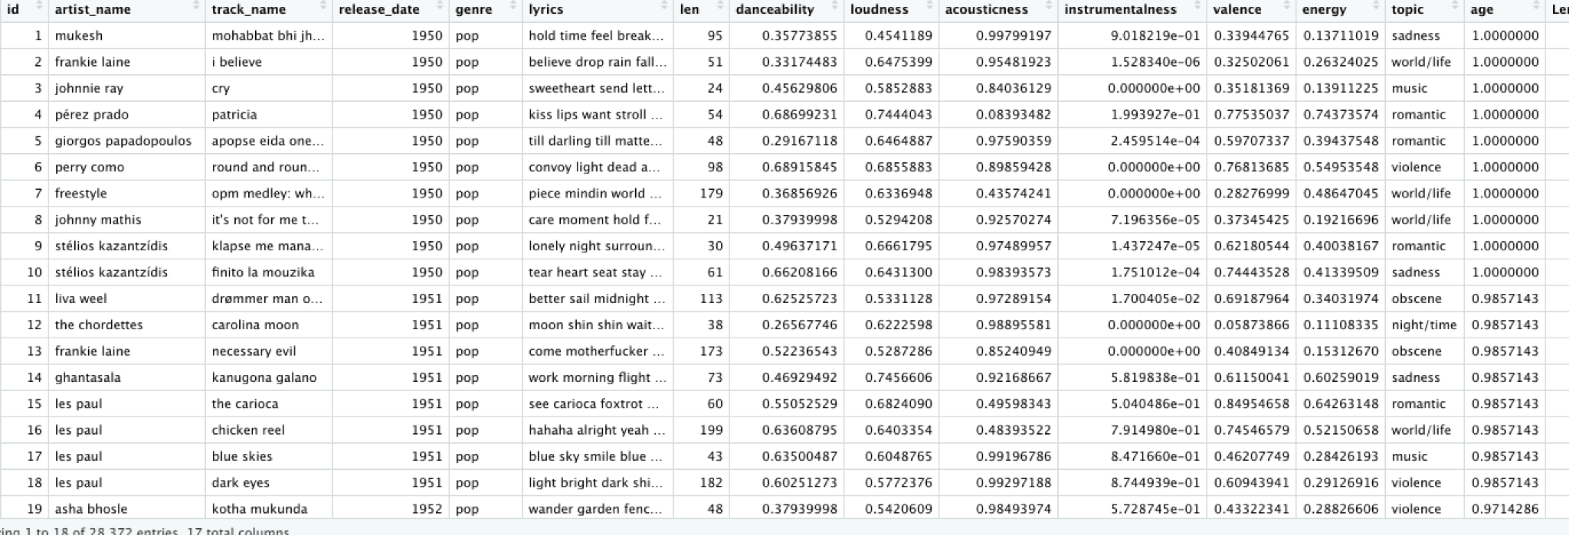
Generation of New Variables
Added ID’s for each song
Added two new variables:
The Normalized length of the songs - Using Min-Max Scaler
The actual age of each song

Slide 7
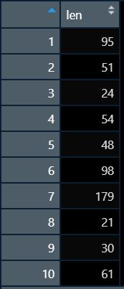
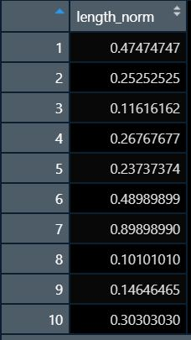
Transformation - Length Normalization

Slide 8
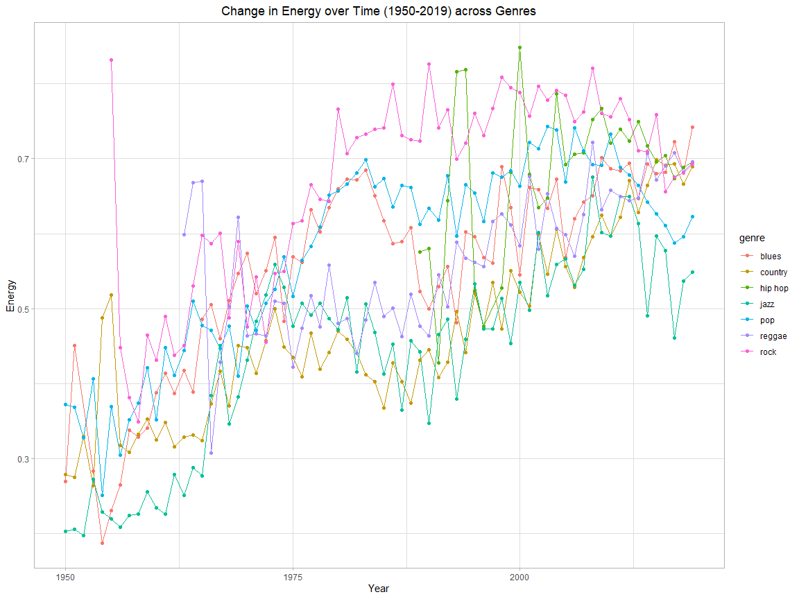
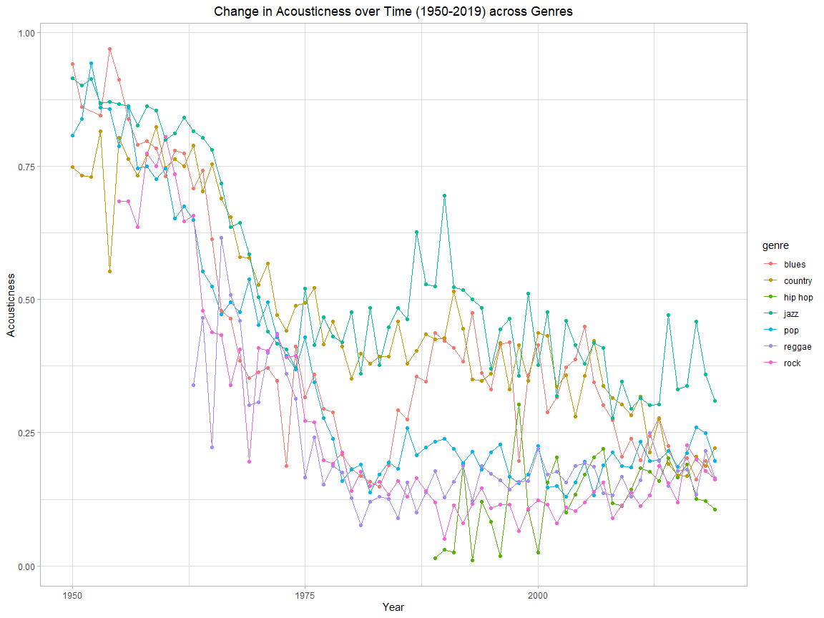
Analysis - Change in Attributes over Time across Genres

Slide 9
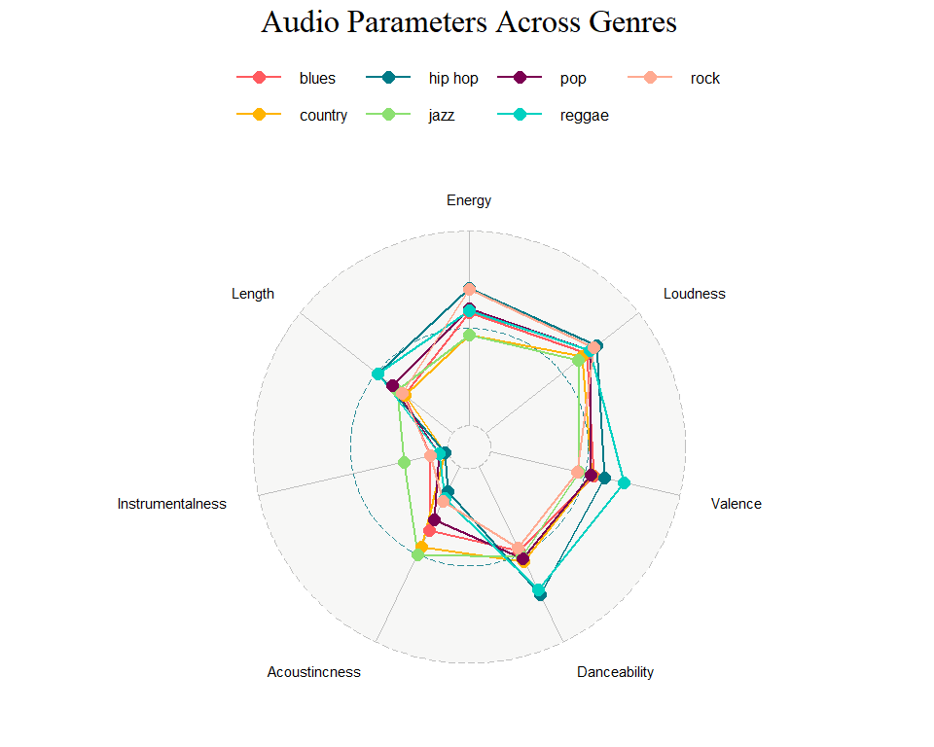
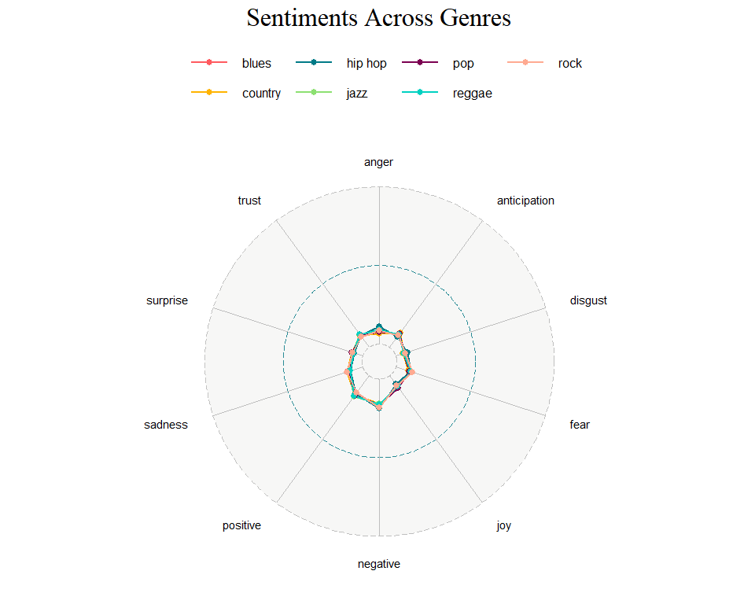
Analysis - Attribute and Sentiment Analysis by Genre

Slide 10

Conclusion/Findings
Pop is the genre with the most released songs
The top three correlated relationships are:
Energy and Loudness
Loudness and Acousticness
Energy and Acousticness
Over time, energy and loudness experienced an upwards trend and acousticness experienced a downwards trend.
No significant difference between sentiments emoted by genre

Slide 11
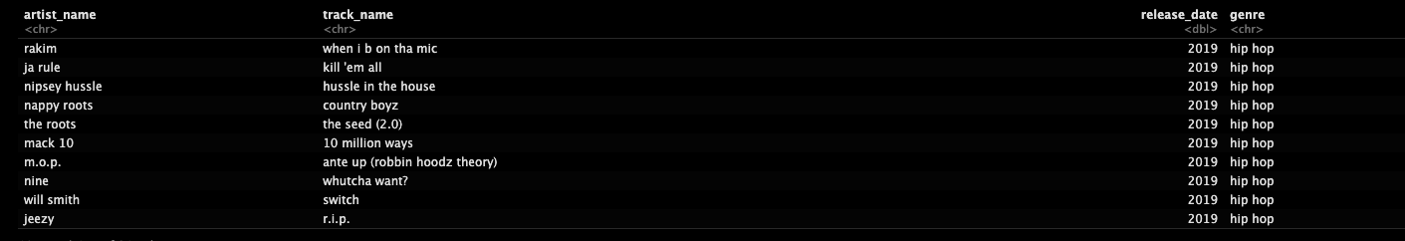
Limitations & Improvements
Issues:
Inaccuracy of release_date variable from the source data - Could be due to a multitude of reasons.
No official variable descriptions were provided which coupled with the lack of exact sources the data was scraped from, made it very hard to describe certain subjectively named variables.
Limitations in R’s Sentiment analysis offerings.
Solutions:
Better data collection or Source Code for collection being made available.
Python’s NLTK library provides more robust features for sentiment analysis.

Slide 12
THANK YOU !!!

